Slide 1
POSH Awareness Training
Creating a Safe and Respectful Workplace

Slide 2
Disclaimer
This session is conducted solely for awareness and educational purposes under the Prevention of Sexual Harassment (POSH) Act, 2013.
Its objective is to promote a safe, respectful, and inclusive workplace for all employees, regardless of gender.

Slide 3
Overview
Understand what constitutes sexual harassment under PoSH
Clarify what does not fall under PoSH
Learn rights, responsibilities & reporting mechanisms
Engage through quizzes and Group discussion
Reinforce a culture of safety, respect, and zero tolerance

Slide 4
Objectives
Know – Distinguish – Report – Act – Respect
Know what constitutes sexual harassment
Distinguish what is and is not covered under PoSH
Report concerns through the right channels
Act responsibly as an employee or bystander
Respect workplace dignity and safety

Slide 5

Question for discussion
“How many of you believe workplace harassment happens in organizations?”

Slide 6
Quiz
1.What does POSH stand for?
Prevention of Social Harassment
Prevention of Sexual Harassment
Protection of Safety and Health
Professional Organization for Safe Habits

Slide 7
2. The POSH Act, 2013 applies to:
Only IT companies
Only government organizations
All workplaces, including public and private sector
Only organizations with more than 500 employees

Slide 8
3.Which of the following is NOT considered sexual harassment?
Unwanted physical contact
Sharing lewd jokes
Constructive feedback on performance
Showing pornography

Slide 9
4.Which of these may be considered sexual harassment under POSH?
Sending repeated personal messages after refusal
Passing comments on appearance
Unwelcome touching or patting
All of the above

Slide 10
5.A senior offering a promotion in exchange for sexual favors is an example of.
Quid Pro Quo harassment
Hostile work environment
Workplace discipline
None of the above

Slide 11
6.As per POSH law, how soon should a complaint be filed from the date of incident?
Within 3 months
Within 6 months
Within 1 year
Anytime

Slide 12
7.A male colleague often forwards memes with sexual innuendos in the office WhatsApp group. Some laugh, but others feel uncomfortable.
What should be done?
Ignore since it’s humour
Report under POSH as it’s unwelcome
Leave the group silently
Tell HR informally without filing a complaint

Slide 13
8.An intern is asked to meet her supervisor at a café late night to “discuss her project.” She/He feels uneasy.
This situation is:
Friendly mentoring
Possible harassment/misuse of authority
Networking opportunity
Nothing wrong since it’s outside office

Slide 14
9.In a POSH workshop, someone says:
“Men can’t be victims of harassment. This law is only for women.”
True
False

Slide 15
10.What do you think is more important between intent & impact?
Impact
Intent
Both impact & intent
Neither impact nor intent

Slide 16

“Myth” or “Fact.”
“Only physical touch counts as sexual harassment.”
“PoSH protects men too.”
“Harassment outside office premises (like office parties) is also covered.”

Slide 17
“What stops most people from reporting harassment?”
A: Fear of retaliation
B: Not knowing the process
C: Believing nothing will change
D: Shame / self-blame
All the above
Notes:
Facilitator Note: Link results to under-reporting statistics (India vs Global) and stress the IC’s supportive role.

Slide 18
PoSH awareness is a continuous reinforcement, not a one-time event.
A safe workplace = Compliance + Culture of Respect.
Quick statistics (global/India cases).

Slide 19
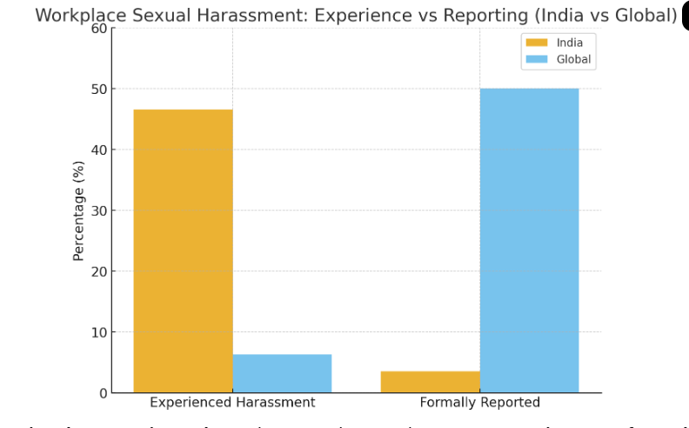
Notes:
Comparison chart showing the gap between experience vs formal reporting of workplace sexual harassment:
In India, nearly 47% of women report experiencing harassment, but only 3.5% formally report.
Globally, around 6.3% report experiencing harassment, and about 50% of those disclose it to someone (though not always formally).

Slide 20
What is Sexual Harassment?
Unwelcome physical, verbal, non-verbal, or digital conduct of a sexual nature.
Creates fear, discomfort, or hostile work environment.

Slide 21

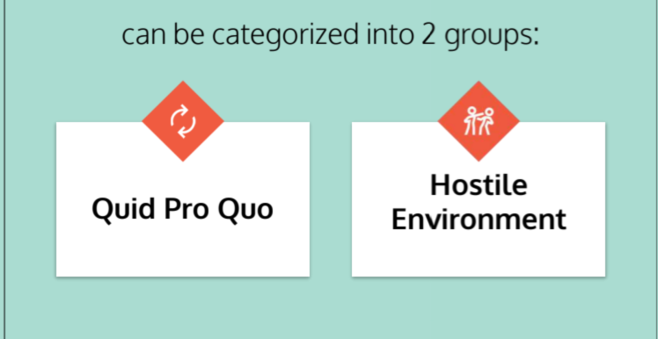

Slide 22
The PoSH Act, 2013 (Prevention of Sexual Harassment at Workplace) is built on three pillars:
Prevention • Prohibition • Redressal

Slide 23

Prevention
🔹 Create awareness through:
Orientation & awareness sessions
Posters, emails, handbooks
Policy communication
🔹 Build a safe culture:
Zero tolerance messages
Encourage respectful behaviour

Slide 24

Prohibition
🚫 Clear ban on:
Any form of sexual harassment at workplace
Retaliation against complainants or witnesses
📌 How?
Display posters at visible places
Written declaration in policies
Management commitment

Slide 25

Redressal
⚖️ Complaint Mechanism:
Internal Committee (IC) in every organization
Safe, fair & confidential process
📅 Timelines:
Complaint → within 3 months of incident
IC Inquiry → within 90 days
Employer Action → within 10 days of IC report

Slide 26

✅ Outcome:
Support to complainant
Disciplinary action if allegations are proven

Slide 27

Scope of POSH
Aggrieved Woman
Working
Visiting a Place
Student
Domestic Worker
Regular,
Temporary,
Ad hoc
With wages, voluntarily
Contractual, Trainee,
Apprentice etc.
Direct/
Through agent

Slide 28

Equality – The Fundamental Right
The Constitution of India provides for Equal treatment for Female & Male in every sphere of the life.

Slide 29
Importance
Gender Sensitivity is one basic requirement for the normal development of an individual.
To build a strong society, Men & women both have to compliment each other.

Slide 30

Question for discussion(Activity)
Notes:
Respect personal space and privacy
Think before you joke
Be sensitive to cultural and gender diversity

Slide 31

⚖️ Types of Workplace Boundaries
Physical Boundaries:
  Respect personal space; avoid unwanted touch or proximity.
  Knock before entering closed workspaces.
Emotional Boundaries:
  Avoid personal remarks or jokes that make others uncomfortable.
  Respect differences in opinions and emotions.
Digital Boundaries:
  Keep work-related communication professional — no inappropriate messages, memes, or late-night texts.
  Respect privacy on social media; don’t share colleagues’ photos or information without consent.
Professional Boundaries:
  Maintain decorum between roles — manager, team member, client, or intern.
  Avoid favoritism or over-familiarity that may cause discomfort or bias.

Slide 32

🌱 Why Boundaries Matter
“Clear boundaries help prevent conflicts and potential harassment.”
“They build mutual respect and psychological safety.”
“Healthy boundaries lead to better teamwork, higher morale, and trust.”
“Respecting boundaries isn’t about being distant — it’s about being considerate. It shows maturity and professionalism.”

Slide 33

“When we understand and respect boundaries, we naturally contribute to a respectful, safe, and inclusive workplace culture.”

Slide 34
Roles & Responsibilities (discussion)
Employees:
Be aware,Respect boundaries, report issues, support peers.
Bystanders:
Speak up or report if you witness misconduct.
Managers:
Lead by example, ensure zero tolerance.
Internal Committee (IC):
Fair, confidential, unbiased and timely investigation.
Notes:
Employees: Be aware,Respect boundaries, report issues, support peers.
Bystanders: Speak up or report if you witness misconduct.
Managers: Lead by example, ensure zero tolerance.
Internal Committee (IC): Fair, confidential, unbiased and timely investigation.

Slide 35

Key Takeaways
Zero Tolerance → No harassment is “too small.”
Speak Up → Silence protects the harasser.
Confidentiality → IC ensures fairness.
Respect Culture → Everyone contributes to a safe workplace.

Slide 36
Myth vs Fact: Understanding PoSH
🔹 Myth 1: Any rude or strict behavior from a manager is a PoSH case.
Fact: PoSH covers only sexual harassment. Strict deadlines, negative feedback, or tough supervision are performance issues, not PoSH.
🔹 Myth 2: Office politics and favoritism fall under PoSH.
Fact: These are workplace concerns, but they don’t qualify as sexual harassment. They are addressed under HR/Grievance policies.

Slide 37
🔹 Myth 3: Consensual relationships at work are always PoSH violations.
Fact: PoSH applies only if there is coercion, exploitation, or lack of consent. Mutual relationships are not violations.
🔹 Myth 4: PoSH covers personal disputes outside work.
Fact: PoSH applies only to workplace-related contexts (including work-from-home, client sites, and official events). Personal disputes without a work connection do not fall under PoSH.
🔹 Myth 5: PoSH is only for women.
Fact: While the Act is women-centric, organizations often extend protection to all employees under internal policy for fairness.

Slide 38
🚫 What is NOT Covered under PoSH? (Group Activity-10 to 15 min)
The PoSH Act deals only with sexual harassment at the workplace.
Please share your thoughts from your experience or you witnessed as a by stander or you can you your gadgets.
These situations are NOT covered under PoSH:
⚖️ Workplace disputes (promotions, transfers, appraisals, performance issues)
🗣️ Professional disagreements or arguments
😐 Rude behavior, bullying, or non-sexual harassment
👥 Consensual relationships between adults
💼 HR or management decisions (salary, leaves, job termination)
🏢 General safety or infrastructure issues (transport, facilities, etc.)
📌 Remember:
PoSH = Sexual Harassment only
Other issues → handled under HR, grievance redressal, or other laws.
Notes:
These situations are NOT covered under PoSH:
⚖️ Workplace disputes (promotions, transfers, appraisals, performance issues)
🗣️ Professional disagreements or arguments
😐 Rude behavior, bullying, or non-sexual harassment
👥 Consensual relationships between adults
💼 HR or management decisions (salary, leaves, job termination)
🏢 General safety or infrastructure issues (transport, facilities, etc.)
📌 Remember:
PoSH = Sexual Harassment only
Other issues → handled under HR, grievance redressal, or other laws.

Slide 39
🚨 Consequences of Sexual Harassment
🔹 For the Victim/Complainant
Emotional distress: stress, anxiety, depression
Loss of confidence & self-esteem
Fear of coming to work, feeling unsafe
Impact on career growth and productivity
Possible absenteeism or resignation

Slide 40
🔹 For the Accused (if proven guilty)
Warning or written apology
Transfer or withholding promotion/increment
Suspension or termination from service
Monetary compensation to the complainant
Ban from future employment in severe cases

Slide 41
For the organization:
Loss of reputation, employee mistrust, reduced productivity, financial/legal penalties for non-compliance.

Slide 42
✅ In short:
Sexual harassment damages people, performance, and productivity.
That’s why the PoSH Act stresses on Prevention, Prohibition, and Redressal.

Slide 43
POSH Internal Committee Members
SL no | Name | Designation
1 | Sanjukta Mitra | Director - Customer Success
2 | Srinivasa Chakravarthy Koya | Managing Director
3 | Lakshmi Sravani Vepachedu | HR Executive
4 | Dittin Manohar Kv | Sr. Account Manager
5 | Sujalatha Baddam | Manager -Talent Acquisition
6 | Rajani Gudise | Manager – Talent Acquisition
7 | Anoop Sai Bandi | Technical Lead
8 | Gayathri Ganiga | Behavioral Trainer

Slide 44
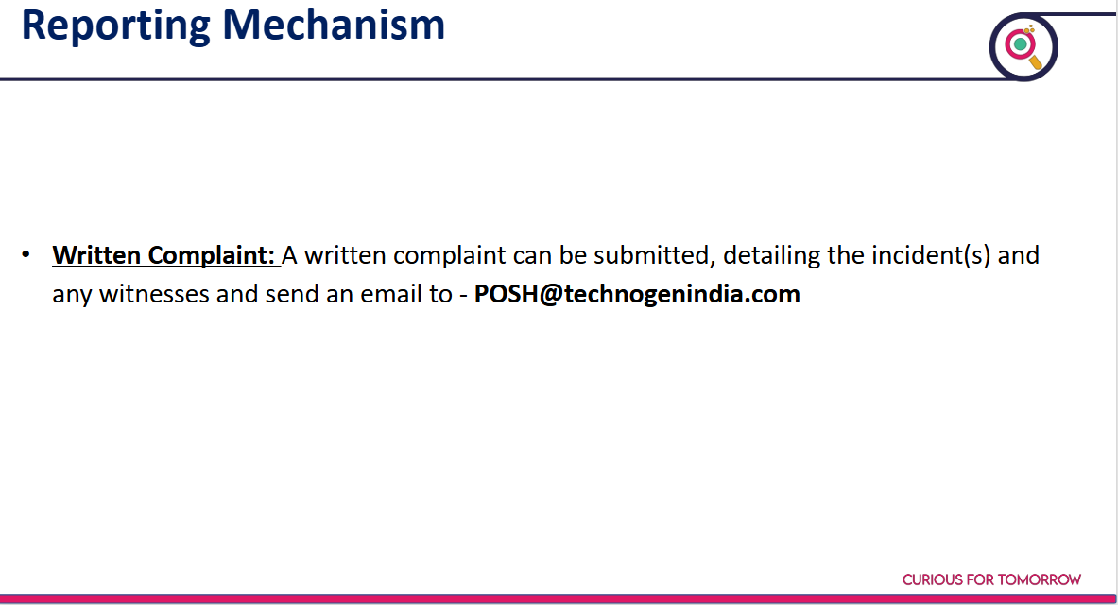

Slide 45
Activity-Personal Commitment (Activity 10 min)
“One action I will take to make my workplace safer.”
Ask employees to type in (if virtual) or write on sticky notes (if physical):
Display them on a wall/board → creates ownership.
Final note: “A respectful workplace is everyone’s responsibility.”
Notes:
Ask employees to type in (if virtual) or write on sticky notes (if physical):
Display them on a wall/board → creates ownership.

Slide 46


Slide 47
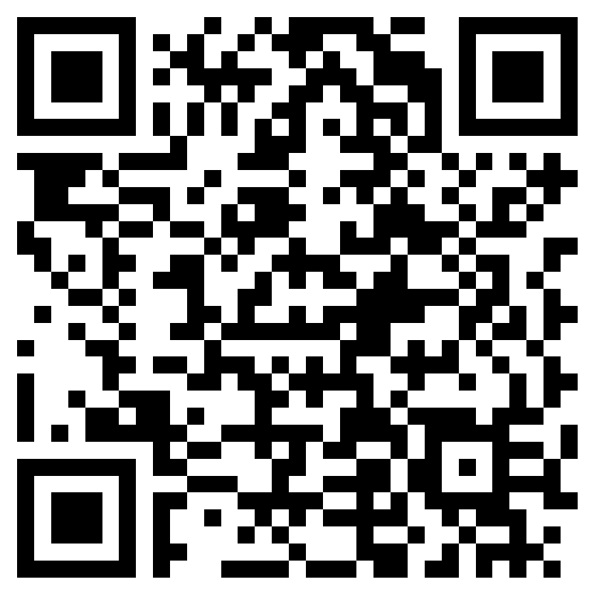
Feedback
https://forms.office.com/r/yLGGPnXsMw?origin=lprLink

